Slide 1
Section Title Slide with Speaker Photo
Please use this template for your ASPEN presentation.
The slides labeled REQUIRED are necessary to ensure ASPEN remains in compliance with various accrediting bodies.
All other slides in this deck are examples. Please delete the ones you do not need.
***Delete instruction boxes when done.***
Speaker Title Slide with photo.
***Delete instruction boxes when done.***
Name, Credentials
Title
Department
Place of work
City, state
Notes:
Read the slide

Slide 2
Section Title Slide Without Speaker Photo
Speaker Title Slide without photo.
***Delete instruction boxes when done.***
Name, Credentials
Title, Department, Place of work
City, state
Notes:
Read the slide

Slide 3
Disclosure
REQUIRED SLIDE: In order to comply with accreditation guidelines, ALL disclosures/relationships with ineligible companies within the past 24 months must be included.
Please list:
Name of company and your affiliation with the company.
Ex: Acme Company, Speaker’s Bureau; Best Company, Consultant
If no conflicts, enter:
No commercial relationships to disclose.
***Delete instruction boxes when done.***
Notes:
Read the Slide

Slide 4
Learning Objectives
REQUIRED SLIDE: Please add at least 3 objectives for your presentation.
For assistance with writing learning objectives, right click on Model of Learning Objectives and then select Open Hyperlink.
***Delete instruction boxes when done.***
Upon completion of this educational activity, the learner will be able to:
Objective one
Objective two
Objective three

Slide 5
Sample Slide With Callout Box
20% of patients with cancer die from malnutrition and not from their underlying disease!

Slide 6
Sample Text Slide
References should be listed at the bottom of the slide and included in the final references slide at the end of this deck.
If the same reference is used on consecutive slides, it should be repeated at the bottom of each slide.
All images must be cited, even if they are screen grabs/taken from the internet.
All references should be compiled into a final References slide at the end of the presentation.
Please follow the AMA style, abbreviating names of journals according to Index Medicus.
***Delete instruction boxes when done.***
Bullet point one
Sub bullet point
Bullet point two
Sub bullet point
Sub bullet point
Bullet point three
Sub bullet point
Please put references on the bottom of the slide and compile them into the final references slide.
Follow the AMA style, abbreviating names of journals according to Index Medicus.

Slide 7
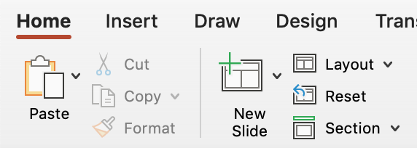
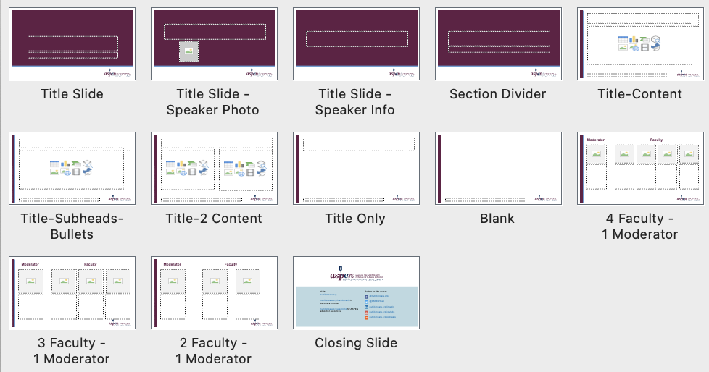
Slide Layouts
This slide shows you how to change the layout for a slide
Note: Animations will not show on the webinar platform, but you can mimic animation by using multiple slides and placing each change on a new slide.
***Delete instruction boxes when done.***
How to access layouts
All layouts are labeled and available in the layout panel of the toolbar
How to use layouts to format
Option 1: “New Slide” in the toolbar will add a new slide and assign it the previously selected layout. To update the layout, go to the layout panel and choose another option.
Option 2: “Copy & Paste” any slide in this template and customize as needed.

Slide 8
Case Study Template - Female
This and other slides show other ways of including content in your presentation. i.e. case studies, charts, graphs, tables, etc.
This information is not required, but can be visually stimulating for the audience. This is considered the descriptive part of the presentation and may be several slides in length.
***Delete instruction boxes when done.***
Was trialed on a Gastrostomy-Jejunostomy and tube feedings along with Parenteral Nutrition (PN) in the past (developed cholestatic liver disease).
Never gained weight on tube feeds. Weight went from 190 to as low as 76 pounds.
Patient was getting by, just eating orally and maintaining weight around 103 pounds, until February of 2020.

Slide 9
Case Study Template – Male
This and other slides show other ways of including content in your presentation. i.e. case studies, charts, graphs, tables, etc.
This information is not required, but can be visually stimulating for the audience. This is considered the descriptive part of the presentation and may be several slides in length.
***Delete instruction boxes when done.***
HPI:
Profuse diarrhea + abdominal pain
Current medications: cyclosporine, prednisolone
Findings:
↑ cyclosporine level
labs consistent with AKI and dehydration
PMH:
Diffuse anaplastic Wilms Tumor w/ pulmonary metastatic disease
Treatment-related Myelodysplastic Syndrome
Day +55 s/p HSCT
Post-HSCT course notable for GI GVHD

Slide 10
Sample Diagram
References should be listed at the bottom of the slide and included in the final references slide at the end of this deck.
If the same reference is used on consecutive slides, it should be repeated at the bottom of each slide.
All references should be compiled into a final References slide at the end of the presentation.
Please follow the AMA style, abbreviating names of journals according to Index Medicus.
***Delete instruction boxes when done.***
xx
x
xx
xx

Slide 11
Table Sample 1
References should be listed at the bottom of the slide and included in the final references slide at the end of this deck.
If the same reference is used on consecutive slides, it should be repeated at the bottom of each slide.
All references should be compiled into a final References slide at the end of the presentation.
Please follow the AMA style, abbreviating names of journals according to Index Medicus.
***Delete instruction boxes when done.***
xx | xx | xx
Intact protein is more trophic | Long-chain triglycerides stimulate adaptation | Disaccharides may be poorly absorbed due to loss of brush border enzymes
Amino-acid based reduces risk of secondary protein intolerance | Medium-chain triglycerides may be better absorbed (independent of bile salts) | Soluble fiber promotes adaptation and can be added when colon is present

Slide 12
Table Sample 2
References should be listed at the bottom of the slide and included in the final references slide at the end of this deck.
If the same reference is used on consecutive slides, it should be repeated at the bottom of each slide.
All references should be compiled into a final References slide at the end of the presentation.
Please follow the AMA style, abbreviating names of journals according to Index Medicus.
***Delete instruction boxes when done.***
xx | xx | xx
High losses after bowel resection, along with Mg + Se Deficiency can present with dermatitis Co-factor for ALP synthesis so ALP levels are low in deficiency | Both have been implicated in IFALD Copper deficiency = pancytopenia Monitor levels | Consider deficiency for patients receiving mostly parenteral nutrition Can usually be replaced enterally due to absorption in the duodenum
xx | xx
In preterms check 25-OH-D after 2 weeks on PN In infants and children check levels every 3-4 months | Patients who have lost significant ileum at high risk for deficiency Monitor levels every 4-6 months

Slide 13
Table Sample 3
References should be listed at the bottom of the slide and included in the final references slide at the end of this deck.
If the same reference is used on consecutive slides, it should be repeated at the bottom of each slide.
All references should be compiled into a final References slide at the end of the presentation.
Please follow the AMA style, abbreviating names of journals according to Index Medicus.
***Delete instruction boxes when done.***
XXX | XXX | XX | XX | XX | XX
06/09/2020 | 134 L | 3.4 L | 8.6 | 4.1 | 2.3
06/10/2020 | 136 | 3.3L | 7.8 L | 3.3 L | 2.6
06/11/2020 | 138 | 4.2 | 8.1 L | 3.1 L | 2.6
06/13/2020 | 136 | 4.4 | 8.9 | 3.8 | 3.8 H

Slide 14
Color Palette
This slide shows ASPEN’s color palette.
***Delete instruction boxes when done.***
Theme Colors – primary brand colors built into template
Secondary Colors
FC4C02
FDB831
679FD5
59C2AD
FFCF85
8363AA
F9A458
F1C586
BAD9E1
BEE3DC
FFE4B8
DDC8DE

Slide 15
Icons
You may use the icons below for ASPEN webinars.
To change the color of an icon, double-click on the icon and choose a new color from the ASPEN palette on the previous slide.
***Delete instruction boxes when done.***
To change the color, double-click on an icon and choose a new color from the ASPEN palette on the previous slide.

Slide 16
Section Divider Slide
Use this slide to separate different topics or sections you need to cover.
***Delete instruction boxes when done.***

Slide 17
Learning Assessment Question 1
Please integrate learning assessment questions into your presentation or at a minimum, include some at the conclusion of your presentation.
Learning assessment questions are a great way to engage the audience and help them learn.
These questions can be used as polling questions. Please notify ASPEN staff if you plan to utilize polling questions.
***Delete instruction boxes when done.***
Multiple choice question 1?
Option 1
Option 2
Option 3
Option 4

Slide 18
Learning Assessment Answer 1
Correct answer in bold/orange. Change letter to orange in the bullets/numbering dropdown.
***Delete instruction boxes when done.***
Multiple choice question 1?
Option 1
Option 2
Option 3
Option 4

Slide 19
References List
REQUIRED SLIDE:
Please compile all your references onto this final References slide. This slide should be at the end of your presentation.
Please follow the AMA style, abbreviating names of journals according to Index Medicus.
***Delete instruction boxes when done.***
Numbered text. Current references to support your overall presentation
Cole BR. Cystinosis and cystinuria. In: Jacobson HR, Striker GE, Klahr S, eds. The Principles and Practice of Nephrology. Philadelphia, PA: BC Decker Inc; 1991:396–403.
Davis JT, Allen HD, Powers JD, Cohen DM. Population requirements for capitation planning in pediatric cardiac surgery. Arch Pediatr Adolesc Med. 1996;150:257–259.

